Slide 1
Recommendation system

Slide 2
Objectives:
Analyze the Dataset
Perform EDA
Apply transformations(Eg: nulls, outliers, standardization)
Develop a Recommendation System
Evaluate the model
Deploy the developed model

Slide 3
DATA OVERVIEW
WE HAVE
rows = 1,00,000 AND columns = 14
The dataset is about educational online courses.
The dataset includes course ratings, instructor information, previous learning history, study material availability, and certification offerings, making it suitable for recommendation models.
We will be developing a Recommendation System based on this dataset.

Slide 4
EDA

Slide 5
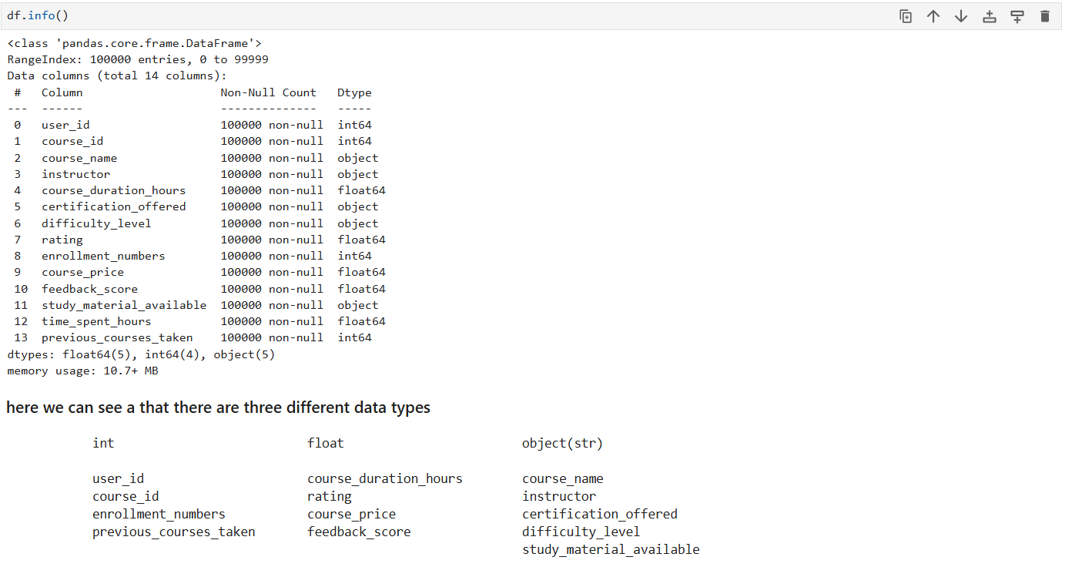
As you can see here of all the data rows there isn’t a single data entry of all the columns that is NULL.
And
We have three datatypes in the entire columns
That are Int, Float, Object.

Slide 6
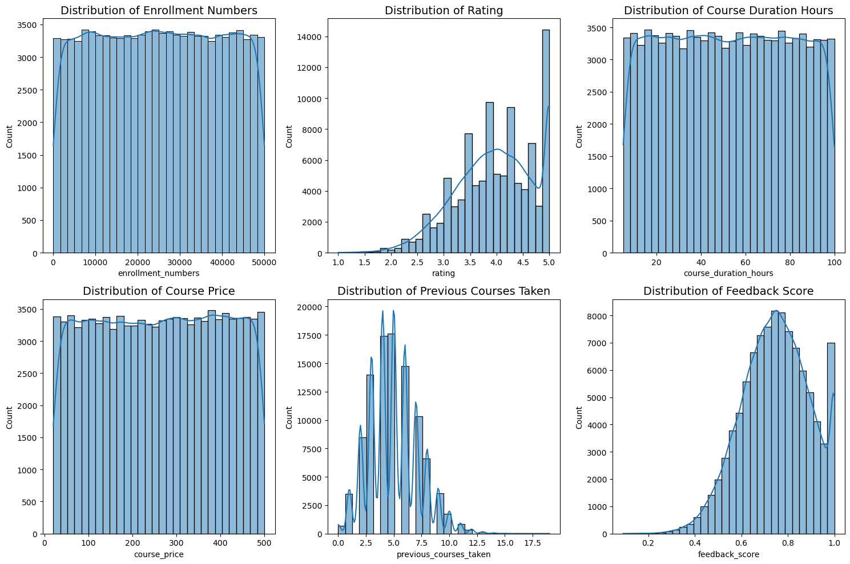
Distributions:
The above visualization provides us the data distribution of numerical variables.
Each Variable Different Distribution like
Rating variable and feedback score have skewed distributions
Previous courses taken variable has normal distribution
The remaining features have almost uniform distributions

Slide 7
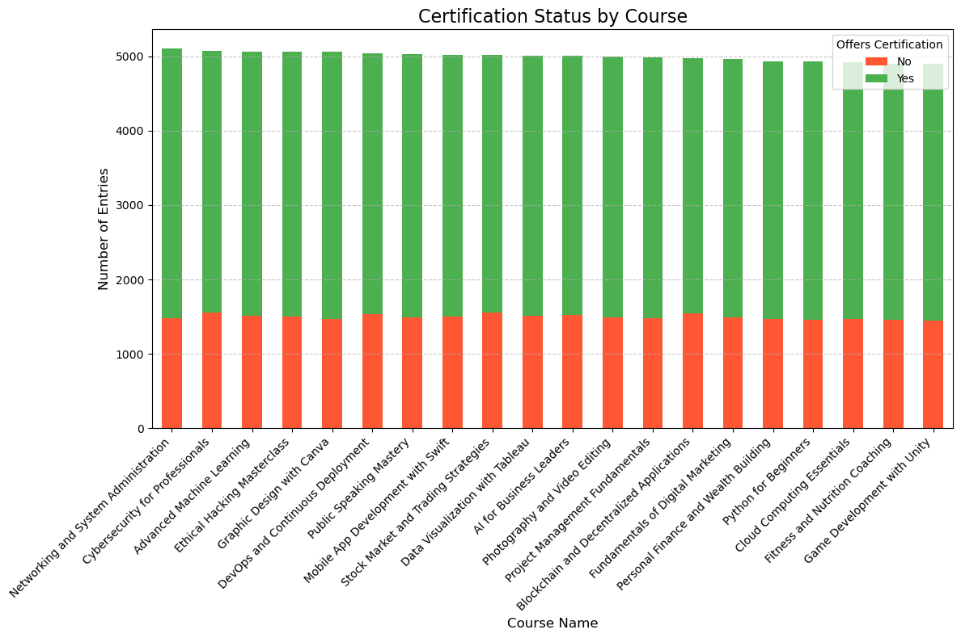
The above virtualization tells us that there are students who was offered a certification and there are students who didn’t.
What we can understand from this is that there may be is some sort of fees that is assigned to the course to get the certification
Example: Coursera.

Slide 8
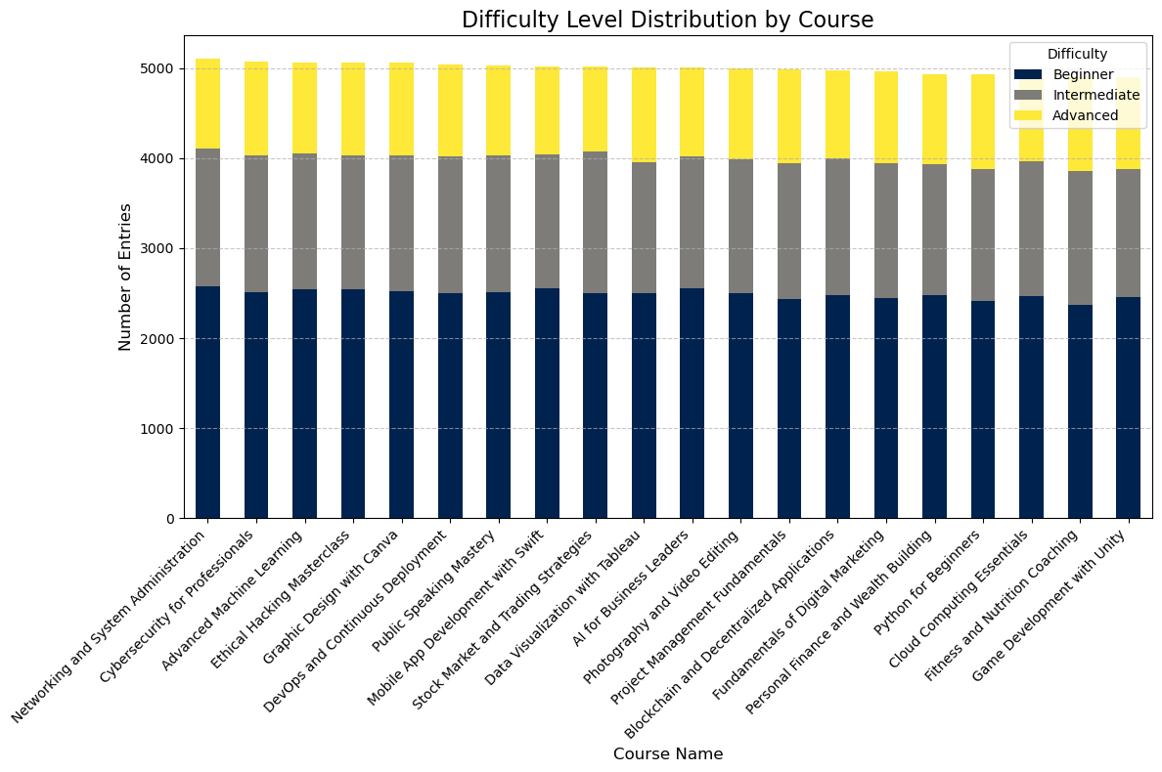
This above Virtualization tells us about the difficult level of the course
Beginner
Intermediate
Advanced

Slide 9
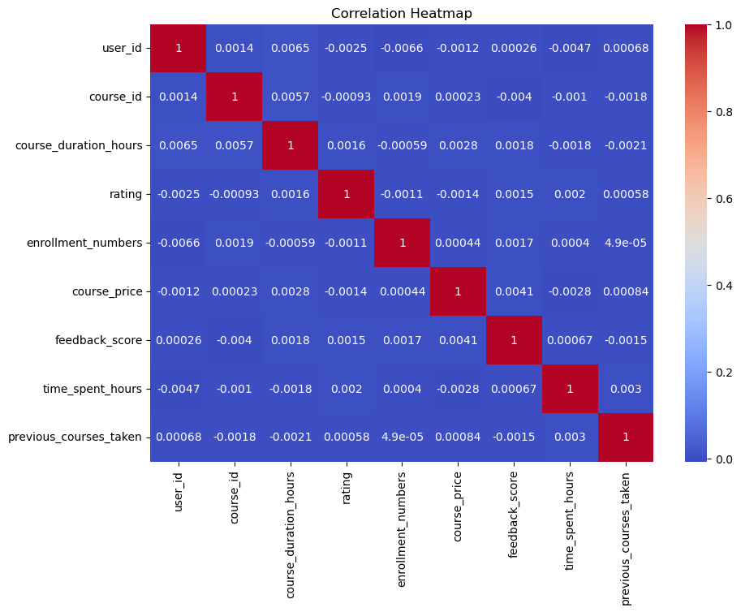
Correlation Matrix
This virtualization tells us that there is Zero correlation b/w the features.

Slide 10
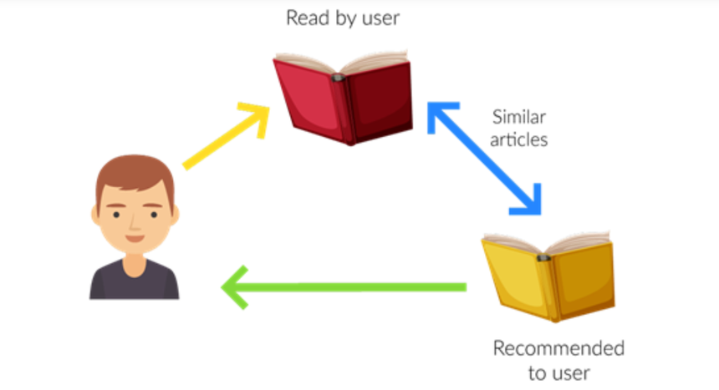
Model Building:
Recommendation System:
A recommendation system, also known as a recommender system or recommendation engine, is a type of information filtering system that uses artificial intelligence (AI) and machine learning (ML) algorithms to predict user preferences and suggest relevant items, products, or content.
We have three types of such systems mainly:
1. Content-based filtering(item-based)
2. Collaborative filtering(user-based)
3. Hybrid models

Slide 11
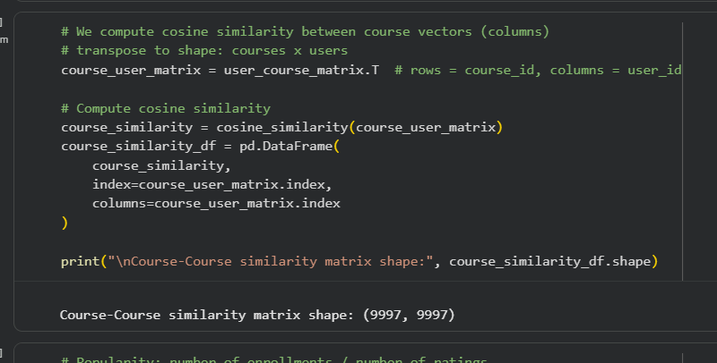
Model Used Collaborative Filtering (Item-Based Recommendation System)
Type: Item–Item Collaborative Filtering
Core Technique: Cosine Similarity
We created a User × Course interaction matrix transpose it to Course × User
Compute cosine similarity between courses
Recommend courses similar to those a user has interacted with

Slide 12
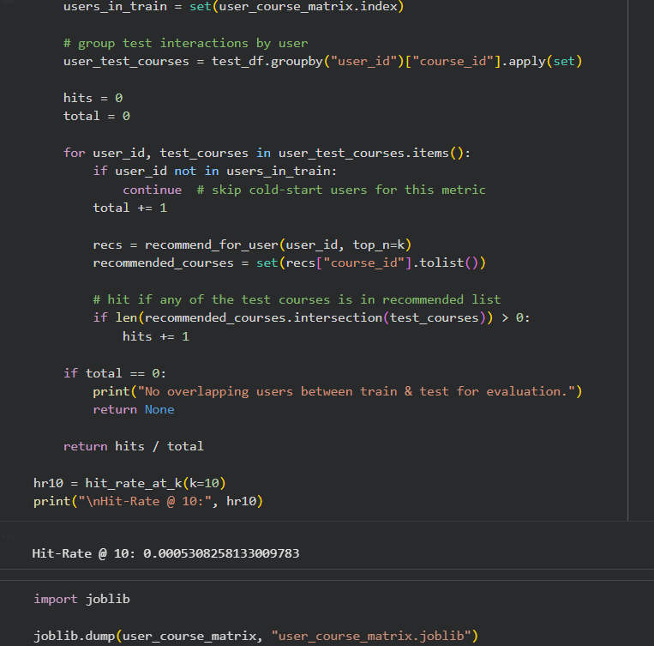
Evaluation Metric Used Hit Rate @ K (Hit-Rate@10) This is a standard recommender-system evaluation metric.
EVALUATION METRIC:
We got
Hit-Rate @ 10: 0.42
Means 42% of users received at least one relevant recommendation in top-10.

Slide 13
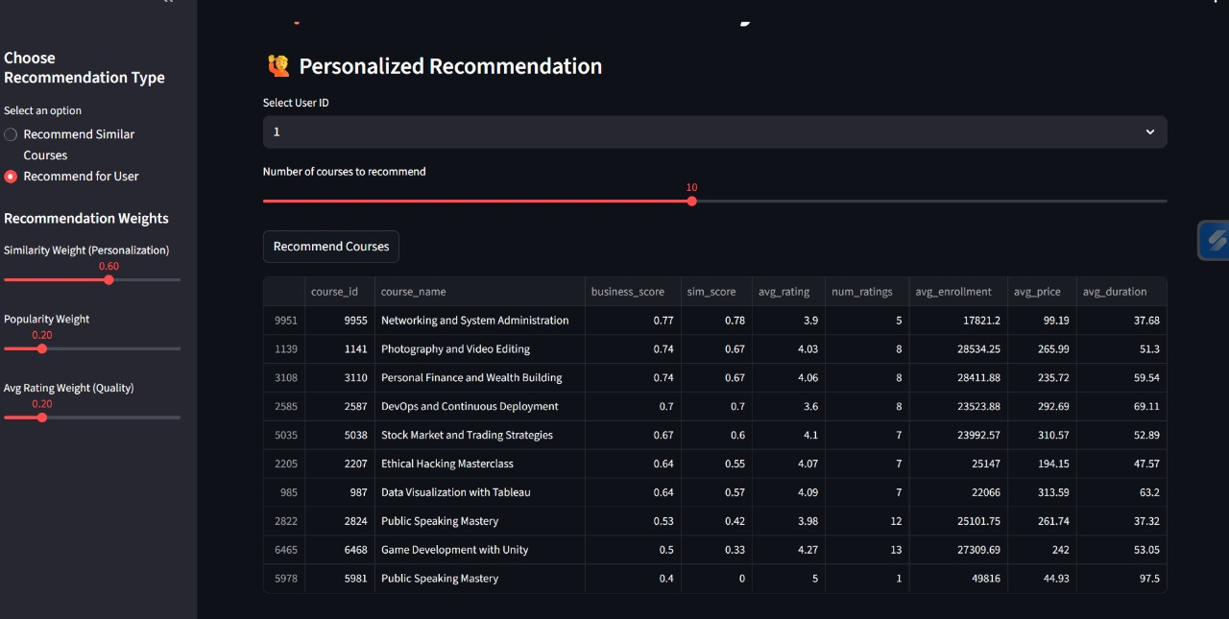
Deployment:

Slide 14
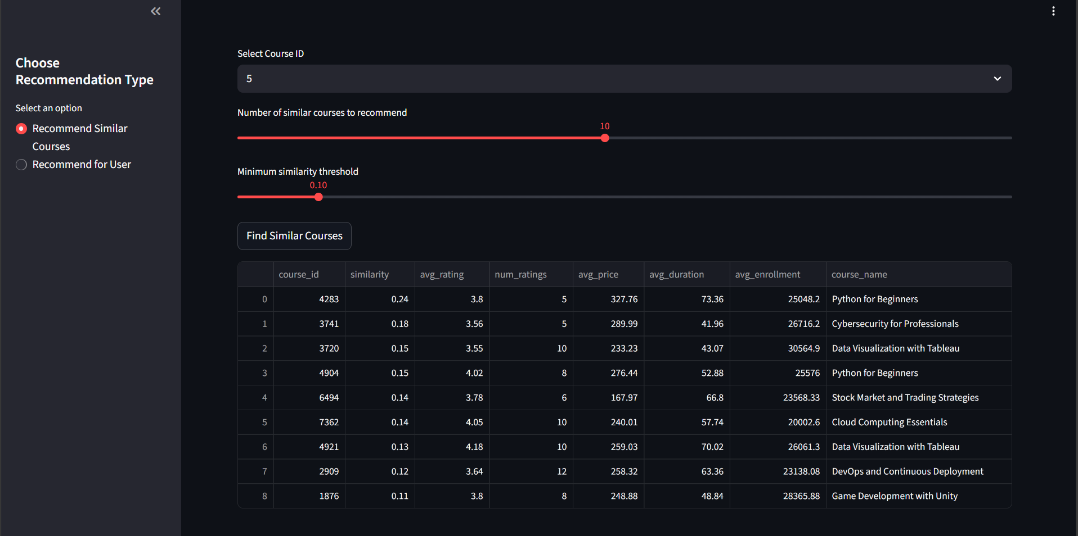

Slide 15
THE END

